Slide 1
The Network Layer in the Internet
The Top 10 principles :
1. Make sure it works : Do not finalize the design or standard until multiple prototypes have successfully communicated with each other. All too often designers first write a 1000-page standard, get it approved, then discover it is deeply flawed and does not work. Then they write version 1.1 of the standard. This is not the way to go.
2. Keep it simple : When in doubt, use the simplest solution. William of Occam stated this principle in the 14th century. Put in modern terms: fight features. If a feature is not absolutely essential, leave it out, especially if the same effect can be achieved by combining other features.
3. Make clear choices : If there are several ways of doing the same thing, choose one. Having two or more ways to do the same thing is looking for trouble. Standards often have multiple options or modes or parameters because several powerful parties insist that their way is best. Designers should strongly resist this tendency. Just say no.
4. Exploit modularity : This principle leads directly to the idea of having protocol stacks, each of whose layers is independent of all the other ones. In this way, if circumstances that require one module or layer to be changed, the other ones will not be affected.

Slide 2
The Network Layer in the Internet
5. Expect heterogeneity : Different types of hardware, transmission facilities, and applications will occur on any large network. To handle them, the network design must be simple, general, and flexible.
6. Avoid static options and parameters : If parameters are unavoidable (e.g.,maximum packet size), it is best to have the sender and receiver negotiate a value than defining fixed choices.
7. Look for a good design : it need not be perfect. Often the designers have a good design but it cannot handle some weird special case. Rather than messing up the design, the designers should go with the good design and put the burden of working around it on the people with the strange requirements.
8. Be strict when sending and tolerant when receiving : In other words, only send packets that rigorously comply with the standards, but expect incoming packets that may not be fully conformant and try to deal with them.
9. Think about scalability : If the system is to handle millions of hosts and billions of users effectively, no centralized databases of any kind are tolerable and load must be spread as evenly as possible over the available resources.
10. Consider performance and cost : If a network has poor performance or outrageous costs, nobody will use it.

Slide 3
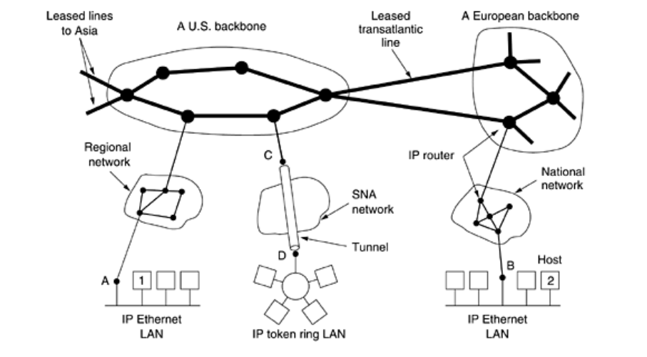
The Network Layer in the Internet
At the network layer, the Internet can be viewed as a collection of subnetworks or Autonomous Systems (ASes) that are interconnected.
There is no real structure, but several major backbones exist. These are constructed from high-bandwidth lines and fast routers.
Attached to the backbones are regional (midlevel) networks, and attached to these regional networks are the LANs at many universities, companies, and Internet service providers.

Slide 4
The Network Layer in the Internet
A good way to think of the network layer is using of IP. Its job is to provide a best-efforts (i.e., not guaranteed) way to transport datagrams from source to destination, without regard to whether these machines are on the same network or whether there are other networks in between them.
The transport layer takes data streams and breaks them up into datagrams. In theory, datagrams can be up to 64 Kbytes each, but in practice they are usually not more than 1500 bytes (so they fit in one Ethernet frame).
Each datagram is transmitted through the Internet, possibly being fragmented into smaller units as it goes.
When all the pieces finally get to the destination machine, they are reassembled by the network layer into the original datagram.
This datagram is then handed to the transport layer,which inserts it into the receiving process' input stream.

Slide 5
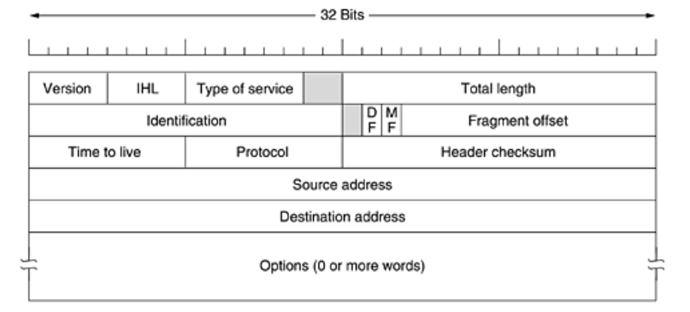
The IPv4 Protocol
An IP datagram consists of a header part and a text part. The header has a 20-byte fixed part and a variable length optional part.
The header format is shown in Figure. It is transmitted in big-endian order: from left to right, with the high-order bit of the Version field going first. Examples :(The SPARC is big endian; the Pentium is little-endian.)
On little endian machines, software conversion is required on both transmission and reception. (hotns, hotnl, noths, nothl).

Slide 6
The IPv4 Protocol
The Version field keeps track of which version of the protocol the datagram belongs to. By including the version in each datagram, it becomes possible to have the transition between versions take years, with some machines running the old version and others running the new one. Currently a transition between IPv4 and IPv6 is going on.
The header length is not constant, a field in the header, IHL, is provided to tell how long the header is, in 32-bit words. The minimum value is 5, which applies when no options are present.
The maximum value of this 4-bit field is 15, which limits the header to 60 bytes, and thus the Options field to 40 bytes. For some options, such as one that records the route a packet has taken, 40 bytes is far too small, making that option useless.
The Type of service field is one of the few fields that has changed its meaning (slightly) over the years. It was and is still intended to distinguish between different classes of service.
Various combinations of reliability and speed are possible. For digitized voice, fast delivery beats accurate delivery. For file transfer, error-free transmission is more important than fast transmission.

Slide 7
The IPv4 Protocol
The 6-bit field contained (from left to right), a three-bit Precedence field and three flags, D, T, and R. The Precedence field was a priority, from 0 (normal) to 7 (network control packet).
The three flag bits allowed the host to specify what it cared most about from the set {Delay, Throughput, Reliability}.
In theory, these fields allow routers to make choices between, for example, a satellite link with high throughput and high delay or a leased line with low throughput and low delay.
In practice, current routers often ignore the Type of service field altogether.
Eventually, IETF threw in the towel and changed the field slightly to accommodate differentiated services. Six of the bits are used to indicate which of the service classes discussed earlier each packet belongs to.
These classes include the four queueing priorities, three discard probabilities, and the historical classes.
The Total length includes everything in the datagram—both header and data. The maximum length is 65,535 bytes. At present, this upper limit is tolerable, but with future gigabit networks, larger datagrams may be needed.

Slide 8
The IPv4 Protocol
The Identification field is needed to allow the destination host to determine which datagram a newly arrived fragment belongs to. All the fragments of a datagram contain the same Identification value.
An unused bit and then two 1-bit fields. DF stands for Don't Fragment. It is an order to the routers not to fragment the datagram because the destination is incapable of putting the pieces back together again.
For example, when a computer boots, its ROM might ask for a memory image to be sent to it as a single datagram.
By marking the datagram with the DF bit, the sender knows it will arrive in one piece, even if this means that the datagram must avoid a small-packet network on the best path and take a suboptimal route. All machines are required to accept fragments of 576 bytes or less.
MF stands for More Fragments. All fragments except the last one have this bit set. It is needed to know when all fragments of a datagram have arrived.
The Fragment offset tells where in the current datagram this fragment belongs. All fragments except the last one in a datagram must be a multiple of 8 bytes, the elementary fragment unit. Since 13 bits are provided, there is a maximum of 8192 fragments per datagram, giving a maximum datagram length of 65,536 bytes, one more than the Total length field.

Slide 9
The IPv4 Protocol
The Time to live field is a counter used to limit packet lifetimes. It is supposed to count time in seconds, allowing a maximum lifetime of 255 sec.
It must be decremented on each hop and is supposed to be decremented multiple times when queued for a long time in a router.
In practice, it just counts hops. When it hits zero, the packet is discarded and a warning packet is sent back to the source host. This feature prevents datagrams from wandering around forever, something that otherwise might happen if the routing tables ever become corrupted.
When the network layer has assembled a complete datagram, it needs to know what to do with it. The Protocol field tells it which transport process to give it to. TCP is one possibility, but so are UDP and some others. The numbering of protocols is global across the entire Internet.
Protocols and other assigned numbers were formerly listed in RFC 1700, but nowadays they are contained in an on-line data base located at www.iana.org.

Slide 10
The IPv4 Protocol
The Header checksum verifies the header only. Such a checksum is useful for detecting errors generated by bad memory words inside a router.
The algorithm is to add up all the 16-bit halfwords as they arrive, using one's complement arithmetic and then take the one's complement of the result. For purposes of this algorithm, the Header checksum is assumed to be zero upon arrival.
This algorithm is more robust than using a normal add. Note that the Header checksum must be recomputed at each hop because at least one field always changes (the Time to live field), but tricks can be used to speed up the computation.
The Source address and Destination address indicate the network number and host number.
The Options field was designed to provide an escape to allow subsequent versions of the protocol to include information not present in the original design, to permit experimenters to try out new ideas, and to avoid allocating header bits to information that is rarely needed.
The options are variable length. Each begins with a 1-byte code identifying the option. Some options are followed by a 1-byte option length field, and then one or more data bytes.
The Options field is padded out to a multiple of four bytes. Originally, five options were defined. The current complete list is now maintained on-line at www.iana.org/assignments/ip-parameters.

Slide 11
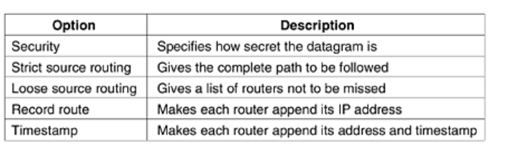
The IPv4 Protocol
The Security option tells how secret the information is. In theory, a military router might use this field to specify not to route through certain countries the military considers to be ''bad guys.''
In practice, all routers ignore it, so its only practical function is to help spies find the good stuff more easily.
The Strict source routing option gives the complete path from source to destination as a sequence of IP addresses.
The datagram is required to follow that exact route. It is most useful for system managers to send emergency packets when the routing tables are corrupted, or for making timing measurements.

Slide 12
The IPv4 Protocol
The Loose source routing option requires the packet to traverse the list of routers specified, and in the order specified, but it is allowed to pass through other routers on the way.
Normally, this option would only provide a few routers, to force a particular path. For example, to force a packet from London to Sydney to go west instead of east, this option might specify routers in New York, Los Angeles, and Honolulu.
This option is most useful when political or economic considerations dictate passing through or avoiding certain countries.
The Record route option tells the routers along the path to append their IP address to the option field. This allows system managers to track down bugs in the routing algorithms.
When the ARPANET was first set up, no packet ever passed through more than nine routers, so 40 bytes of option was ample.
Finally, the Timestamp option is like the Record route option, except that in addition to recording its 32-bit IP address, each router also records a 32-bit timestamp. This option, too, is mostly for debugging routing algorithms.

Slide 13
IP Addresses
Every host and router on the Internet has an IP address, which encodes its network number and host number. The combination is unique: in principle, no two machines on the Internet have the same IP address.
All IP addresses are 32 bits long and are used in the Source address and Destination address fields of IP packets. It is important to note that an IP address does not actually refer to a host.
It really refers to a network interface, so if a host is on two networks, it must have two IP addresses. However, in practice, most hosts are on one network and thus have one IP address.
For several decades, IP addresses were divided into the five categories listed in figure. This allocation has come to be called classful addressing.
Classful addressing is an early method used in IP networks to divide the IP address space into different classes based on fixed boundaries. Classful addressing wasted many IPv4 addresses.
This system was part of the original IPv4 addressing scheme, designed to make it easier to allocate addresses based on the size and needs of different networks. Here’s a breakdown of how classful addressing works.

Slide 14
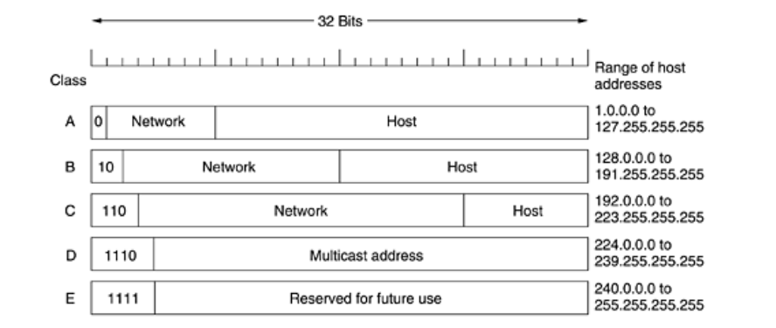
IP Addresses

Slide 15
IP Addresses
Class A
Range: 1.0.0.0 to 126.0.0.0
Network Portion: 8 bits
Host Portion: 24 bits
Default Subnet Mask: 255.0.0.0
Purpose: Designed for very large networks, with up to 16 million hosts per network.
First Octet Range: 1-126 (where 127 is reserved for loopback addresses)
Class B
Range: 128.0.0.0 to 191.255.0.0
Network Portion: 16 bits
Host Portion: 16 bits
Default Subnet Mask: 255.255.0.0
Purpose: Suitable for medium-sized networks, with up to 65,000 hosts per network.
First Octet Range: 128-191
Class C
Range: 192.0.0.0 to 223.255.255.0, Network Portion: 24 bits
Host Portion: 8 bits Default Subnet Mask: 255.255.255.0 , Purpose: Best for small networks, with up to 254 hosts per network, First Octet Range: 192-223

Slide 16
IP Addresses
Class D (Multicast)
Range: 224.0.0.0 to 239.255.255.255, Purpose: Reserved for multicast groups, where data is sent to multiple destinations at once.
First Octet Range: 224-239
Class E (Experimental)
Range: 240.0.0.0 to 255.255.255.255, Purpose: Reserved for experimental purposes and future use, not used for regular IP addressing, First Octet Range: 240-255
Key Characteristics :
Fixed Boundaries: Classful addressing used fixed boundaries to determine network and host portions of the IP address, which could lead to inefficient use of IP address space.
No Subnetting: Classful addressing did not support subnetting within classes, which meant you had to work within the constraints of the class’s fixed subnet mask.
Address Exhaustion: As the Internet grew, classful addressing led to inefficient use of IP addresses, contributing to the depletion of available IPv4 addresses.

Slide 17
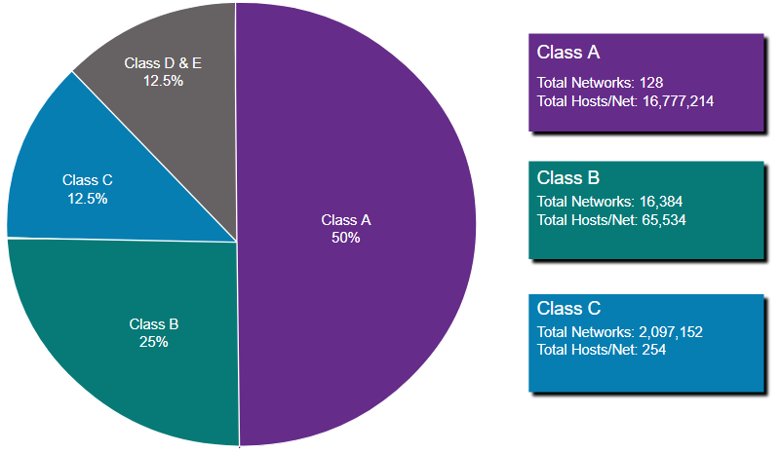
IP Addresses
RFC 790 (1981) allocated IPv4 addresses in classes :
Class A (0.0.0.0/8 to 127.0.0.0/8)
Class B (128.0.0.0 /16 – 191.255.0.0 /16)
Class C (192.0.0.0 /24 – 223.255.255.0 /24)
Class D (224.0.0.0 to 239.0.0.0)
Class E (240.0.0.0 – 255.0.0.0)

Slide 18
IP Addresses
The class A, B, C, and D formats allow for up to 128 networks with 16 million hosts each, 16,384 networks with up to 64K hosts, and 2 million networks (e.g., LANs) with up to 256 hosts each (although a few of these are special). Also supported is multicast, in which a datagram is directed to multiple hosts.
Addresses beginning with 1111 are reserved for future use. Over 500,000 networks are now connected to the Internet, and the number grows every year.
Network numbers are managed by a nonprofit corporation called ICANN (Internet Corporation for Assigned Names and Numbers) to avoid conflicts.
In turn, ICANN has delegated parts of the address space to various regional authorities, which then dole out IP addresses to ISPs and other companies.
Network addresses, which are 32-bit numbers, are usually written in dotted decimal notation. In this format, each of the 4 bytes is written in decimal, from 0 to 255.
For example, the 32-bit hexadecimal address C0290614 is written as 192.41.6.20. The lowest IP address is 0.0.0.0 and the highest is 255.255.255.255.

Slide 19
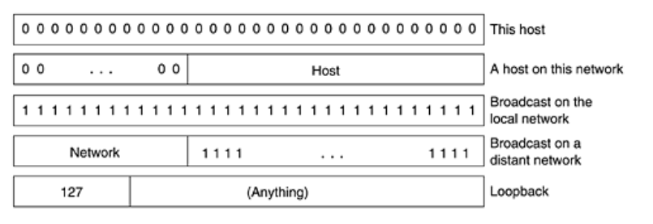
Special IP Addresses

Slide 20
IP Addresses
The values 0 and 1 (all 1s) have special meanings, as shown in figure. The value 0 means this network or this host. The value of 1 is used as a broadcast address to mean all hosts on the indicated network.
The IP address 0.0.0.0 is used by hosts when they are being booted. IP addresses with 0 as network number refer to the current network.
These addresses allow machines to refer to their own network without knowing its number. The address consisting of all 1s allows broadcasting on the local network, typically a LAN.
The addresses with a proper network number and all 1s in the host field allow machines to send broadcast packets to distant LANs anywhere in the Internet. Finally, all addresses of the form 127.xx.yy.zz are reserved for loopback testing.
Packets sent to that address are not put out onto the wire; they are processed locally and treated as incoming packets. This allows packets to be sent to the local network without the sender knowing its number.

Slide 21
IP Addresses
As defined in in RFC 1918, public IPv4 addresses are globally routed between internet service provider (ISP) routers.
Private addresses are common blocks of addresses used by most organizations to assign IPv4 addresses to internal hosts.
Private IPv4 addresses are not unique and can be used internally within any network.
However, private addresses are not globally routable.
Network Address and Prefix | RFC 1918 Private Address Range
10.0.0.0/8 | 10.0.0.0 - 10.255.255.255
172.16.0.0/12 | 172.16.0.0 - 172.31.255.255
192.168.0.0/16 | 192.168.0.0 - 192.168.255.255

Slide 22
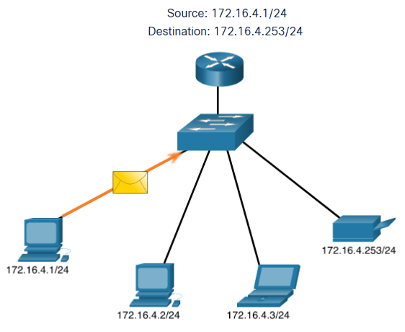
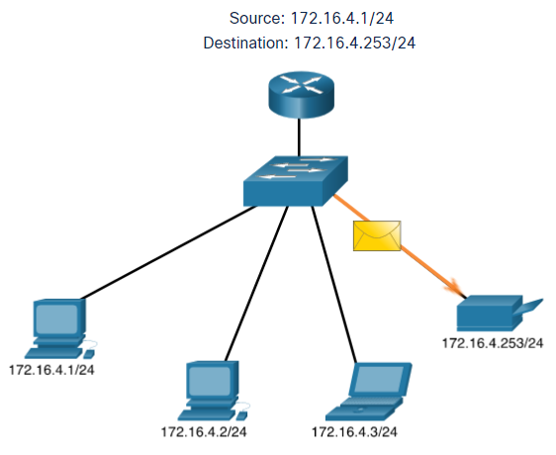
IPv4 Unicast
Unicast transmission is sending a packet to one destination IP address.
For example, the PC at 172.16.4.1 sends a unicast packet to the printer at 172.16.4.253.
Notes:
11 – IPv4 Addressing
11.2 – IPv4 Unicast, Broadcast, and Multicast
11.2.1 – Unicast

Slide 23
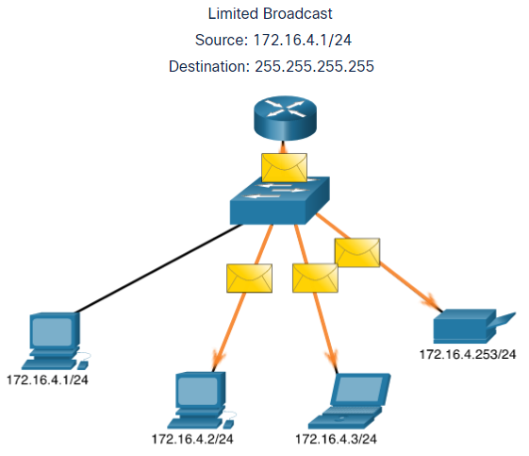
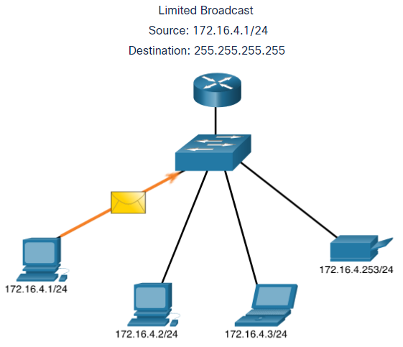
IPV4 - Broadcast
Broadcast transmission is sending a packet to all other destination IP addresses.
For example, the PC at 172.16.4.1 sends a broadcast packet to all IPv4 hosts.
Notes:
11 – IPv4 Addressing
11.2 – IPv4 Unicast, Broadcast, and Multicast
11.2.2 – Broadcast

Slide 24
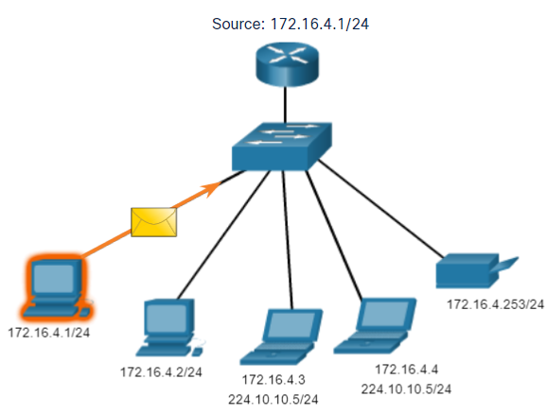
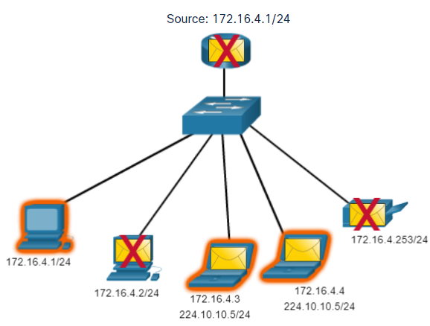
IPV4 Multicast
Multicast transmission is sending a packet to a multicast address group.
For example, the PC at 172.16.4.1 sends a multicast packet to the multicast group address 224.10.10.5.
Notes:
11 – IPv4 Addressing
11.2 – IPv4 Unicast, Broadcast, and Multicast
11.2.3 – Multicast
11.2.4 – Activity - Unicast, Broadcast, or Multicast

Slide 25
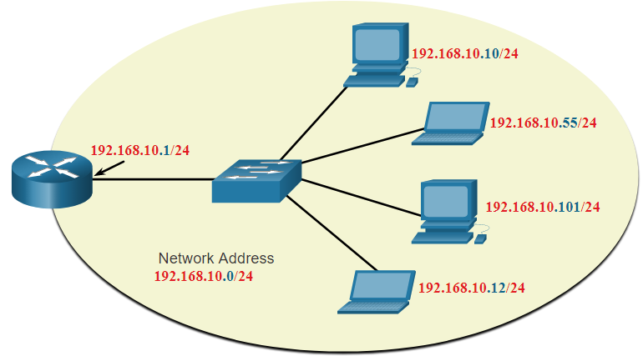
IPv4 Address Structure Network, Host, and Broadcast Addresses
Within each network are three types of IP addresses:
Network address
Host addresses
Broadcast address
 | Network Portion | Host Portion | Host Bits
Subnet mask 255.255.255.0 or /24 | 255 255 255 11111111 11111111 11111111 | 0 00000000
Network address 192.168.10.0 or /24 | 192 168 10 11000000 10101000 00001010 | 0 00000000 | All 0s
First address 192.168.10.1 or /24 | 192 168 10 11000000 10101000 00001010 | 1 00000001 | All 0s and a 1
Last address 192.168.10.254 or /24 | 192 168 10 11000000 10101000 00001010 | 254 11111110 | All 1s and a 0
Broadcast address 192.168.10.255 or /24 | 192 168 10 11000000 10101000 00001010 | 255 11111111 | All 1s
Notes:
11 – IPv4 Addressing
11.1 – IPv4 Address Structure
11.1.6 – Network, Host, and Broadcast Addresses
11.1.7 – Activity – ANDing to Determine the Network Address
11.1.8 – Check Your Understanding - IPv4 Address Structure

Slide 26
IPv4 Address Structure The Prefix Length
A prefix length is a less cumbersome method used to identify a subnet mask address.
The prefix length is the number of bits set to 1 in the subnet mask.
It is written in “slash notation” therefore, count the number of bits in the subnet mask and prepend it with a slash.
Subnet Mask | 32-bit Address | Prefix Length
255.0.0.0 | 11111111.00000000.00000000.00000000 | /8
255.255.0.0 | 11111111.11111111.00000000.00000000 | /16
255.255.255.0 | 11111111.11111111.11111111.00000000 | /24
255.255.255.128 | 11111111.11111111.11111111.10000000 | /25
255.255.255.192 | 11111111.11111111.11111111.11000000 | /26
255.255.255.224 | 11111111.11111111.11111111.11100000 | /27
255.255.255.240 | 11111111.11111111.11111111.11110000 | /28
255.255.255.248 | 11111111.11111111.11111111.11111000 | /29
255.255.255.252 | 11111111.11111111.11111111.11111100 | /30
Notes:
11 – IPv4 Addressing
11.1 – IPv4 Address Structure
11.1.3 – The Prefix Length

Slide 27
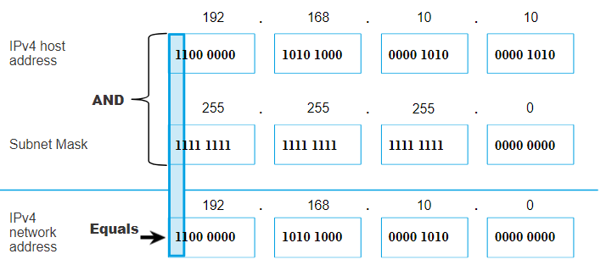
IPv4 Address Structure Determining the Network: Logical AND
A logical AND Boolean operation is used in determining the network address.
Logical AND is the comparison of two bits where only a 1 AND 1 produces a 1 and any other combination results in a 0.
1 AND 1 = 1, 0 AND 1 = 0, 1 AND 0 = 0, 0 AND 0 = 0
1 = True and 0 = False
To identify the network address, the host IPv4 address is logically ANDed, bit by bit, with the subnet mask to identify the network address.
Notes:
11 – IPv4 Addressing
11.1 – IPv4 Address Structure
11.1.4 – Determining the Network: Logical AND

